Slide 1
Huffman Coding

Slide 2
Data Compression
Suppose we have 1000000000 (1G) character data file that we wish to include in an email.
Suppose file only contains 26 letters {a,…,z}.
Suppose each letter α in {a,…,z} occurs with frequency f_{α}.
Suppose we encode each letter by a binary code
If we use a fixed length code, we need 5 bits for each character
The resulting message length is
Can we do better?

Slide 3
Huffman Codes
Most character code systems (ASCII, unicode) use fixed length encoding
If frequency data is available and there is a wide variety of frequencies, variable length encoding can save 20% to 90% space
Which characters should we assign shorter codes; which characters will have longer codes?

Slide 4
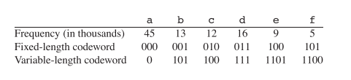
Data Compression: A Smaller Example
Suppose the file size is 100000 characters and contains only 6 letters {a,b,c,d,e,f} with frequencies
Fixed length 3*100000=300000 bits
Variable length

Slide 5
How to decode?
At first it is not obvious how decoding will happen, but this is possible if we use prefix codes
no codeword is also a preﬁx of some other codeword

Slide 6
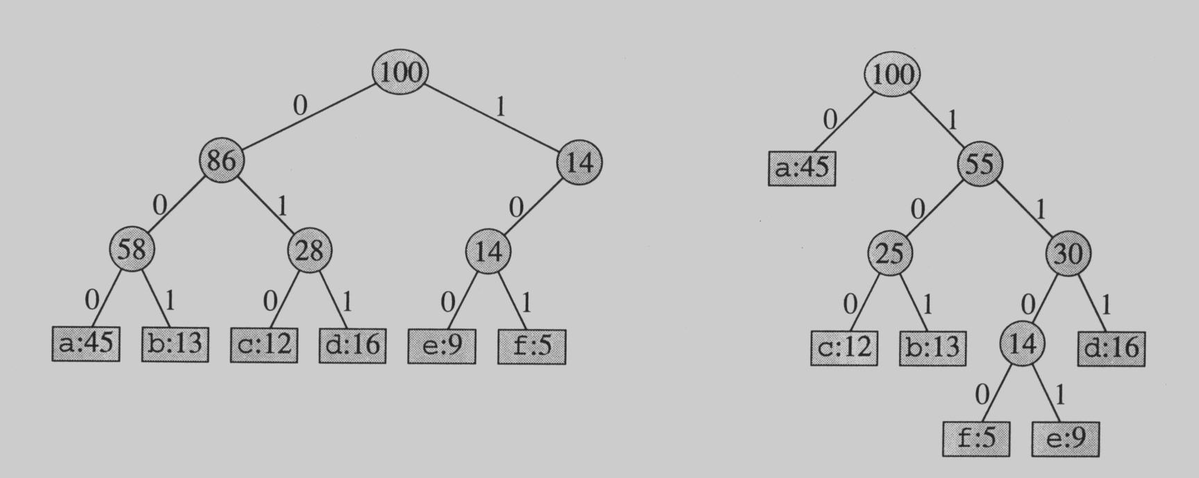
Prefix Codes
No encoding of a character can be the prefix of the longer encoding of another character, for example, we could not encode t as 01 and x as 01101 since 01 is a prefix of 01101
By using a binary tree representation we will generate prefix codes provided all letters are leaves

Slide 7
Prefix codes
A message can be decoded uniquely.
Following the tree until it reaches to a leaf, and then repeat!
Draw a few more tree and produce the codes!!!

Slide 8
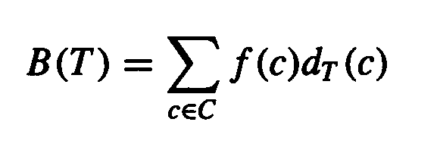
Some Properties
Prefix codes allow easy decoding
  Given a: 0, b: 101, c: 100, d: 111, e: 1101, f: 1100
  Decode 001011101 going left to right, 0|01011101, a|0|1011101, a|a|101|1101, a|a|b|1101, a|a|b|e
An optimal code must be a full binary tree (a tree where every internal node has two children)
For C leaves there are C-1 internal nodes
The number of bits to encode a file is
where f(c) is the freq of c, d_{T}(c) is the tree depth of c, which corresponds to the code length of c

Slide 9
Optimal Prefix Coding Problem
Input: Given a set of n letters (c₁,…, c_{n}) with frequencies (f₁,…, f_{n}).
Construct a full binary tree T to define a prefix code that minimizes the average code length

Slide 10
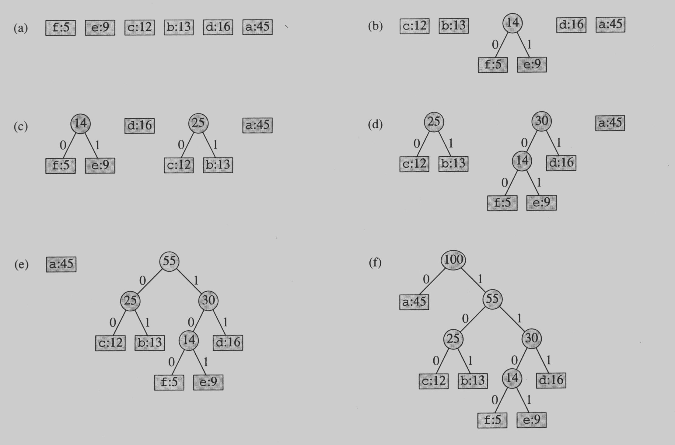
Building the Encoding Tree

Slide 11
Building the Encoding Tree

Slide 12
Building the Encoding Tree

Slide 13
Building the Encoding Tree

Slide 14
Building the Encoding Tree

Slide 15
Example:
Alphabet: A, B, C, D, E, F
Frequency table:
F | E | D | C | B | A
60 | 50 | 40 | 30 | 20 | 10
Total File Length: 210

Slide 16
The Huffman encoding:
A: 1000
B: 1001
C: 101
D: 00
E: 01
F: 11
V 210
0
1
Z 90
W 120
1
0
0
1
D 40
E 50
Y 60
F 60
1
0
X 30
C 30
0
1
A 10
B 20
File Size: 10x4 + 20x4 + 30x3 + 40x2 + 50x2 + 60x2 =
40 + 80 + 90 + 80 + 100 + 120 = 510 bits

Slide 17
Note the savings:
The Huffman code:
Required 510 bits for the file.
Fixed length code:
Need 3 bits for 6 characters.
File has 210 characters.
Total: 630 bits for the file.

Slide 18
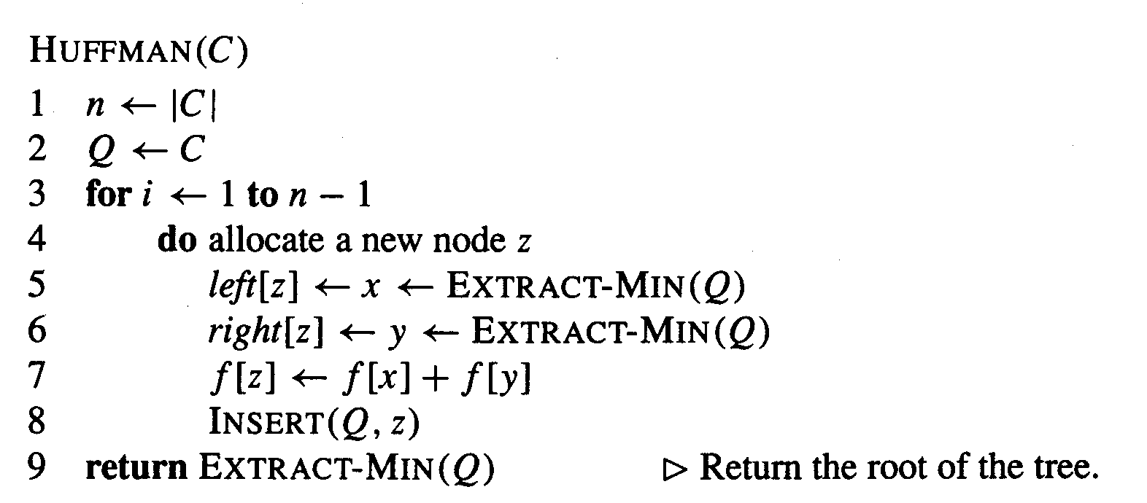
The Algorithm
An appropriate data structure is a binary min-heap
Rebuilding the heap is lg n and n-1 extractions are made, so the complexity is O( n lg n )
The encoding is NOT unique, other encoding may work just as well, but none will work better

Slide 19
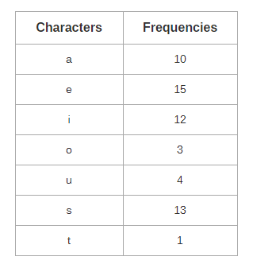
Example:

Slide 20
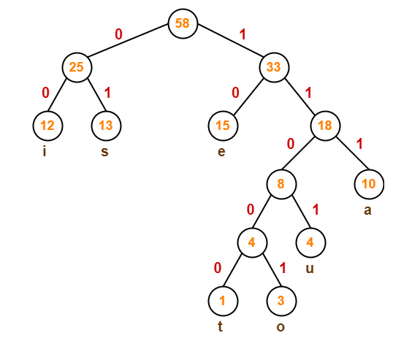
a = 111
e = 10
i = 00
o = 11001
u = 1101
s = 01
t = 11000

Slide 21
Average code length
= ∑ ( frequency_{i} x code length_{i} ) / ∑ ( frequency_{i} )
= { (10 x 3) + (15 x 2) + (12 x 2) + (3 x 5) + (4 x 4) + (13 x 2) + (1 x 5) } / (10 + 15 + 12 + 3 + 4 + 13 + 1)
= 2.52
Total number of bits in Huffman encoded message
= Total number of characters in the message x Average code length per character
= 58 x 2.52
= 146.16
≅ 147 bits

Slide 22
Job Scheduling with Deadline

Slide 23
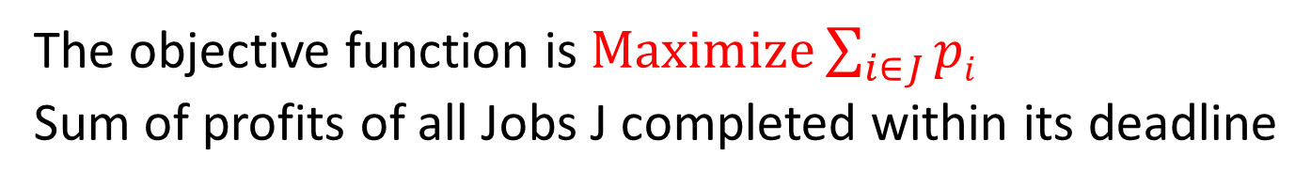
Problem Statement
The problem is stated as below.
There are n jobs to be processed on a machine.
Each job i has a deadline d_{i}≥ 0 and profit p_{i}≥0 .
p_{i} is earned iff the job is completed by its deadline.
The job is completed if it is processed on a machine for unit time.
Only one machine is available for processing jobs.
Only one job is processed at a time on the machine.
The objective function is $Maximize\sum_{i∈J}{pi}$
Sum of profits of all Jobs J completed within its deadline
Notes:
Each task in the decending order of their profit and schedule it in the Latest possible free slot that meets its deadline . If no such slot is there don’t schedule the task.

Slide 24
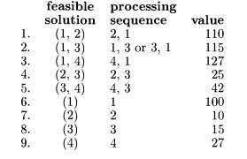
n = 4, (p1,p2,P3,P4) = (100,10,15,27) and (d1,d2, d3,d4)=(2,1, 2,1)

Slide 25
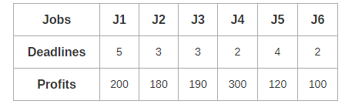
Example Problem

Slide 26
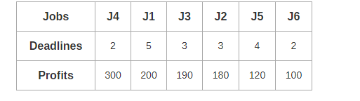
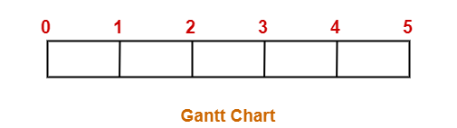
Step-1:
Sort all the given jobs in decreasing order of their profit-
Step-02:
Value of maximum deadline = 5.
So, draw a Gantt chart with maximum time on Gantt chart = 5 units as shown-

Slide 27
Further Steps are done in this way
0
1
2
3
4
5
 | J4
0
1
2
3
4
5
 | J4 |  |  | J1
0
1
2
3
4
5
 | J4 | J3 |  | J1
0
1
2
3
4
5
J2 | J4 | J3 |  | J1
0
1
2
3
4
5
J2 | J4 | J3 | J5 | J1

Slide 28
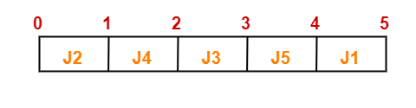
The optimal schedule is-
J2 , J4 , J3 , J5 , J1
Maximum earned profit
= Sum of profit of all the jobs in optimal schedule
= Profit of job J2 + Profit of job J4 + Profit of job J3 + Profit of job J5 + Profit of job J1
= 180 + 300 + 190 + 120 + 200
= 990 units

Slide 29
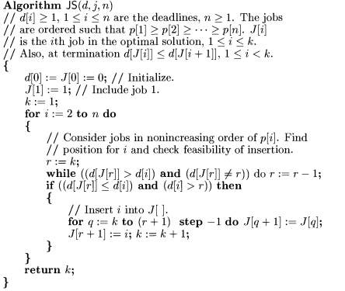
Algorithm:

